Slide 1

Digital Clinical Judgment Mentor
Making The Connection Between Theory And Practice
By putting clinical decision support at novice nurses and nursing student’s fingertips.
Team :
Susan McCabe MSHI, MS, RN, ANP, CNE
Pao-Chu Tseng, PhD, RN, CSN
Dominic Surrao , MS Developer
Team 508 Digital Clinical Judgment Mentor

Slide 2

The problem: Nursing students need clinical decision support learning tools to practice in clinical settings ….
Team 508 Digital Clinical Judgment Mentor
Notes:
Consider the student nurse experience:
Alone, encountering highly complex patient situations.
Cognitive overload and freeze.
They can collect data and click buttons, but they can’t interpret data.
They can’t grasp cues that indicate that there is a problem.
They don’t know when to see help.
Their clinical experience reinforces what they don’t know.

Slide 3

Bottom Line…
It takes $82,000 to replace a nurse before onboarding and training even begin.
Conservative estimates indicate hospitals average spending $50-100,000 per RN in orientation.
If 181,000 RNs passed NCLEX in 2020,
32.9 billion health care dollars were placed at risk.
Team 508 Digital Clinical Judgment Mentor

Slide 4

Solution
Team 508 Digital Clinical Judgment Mentor

Slide 5
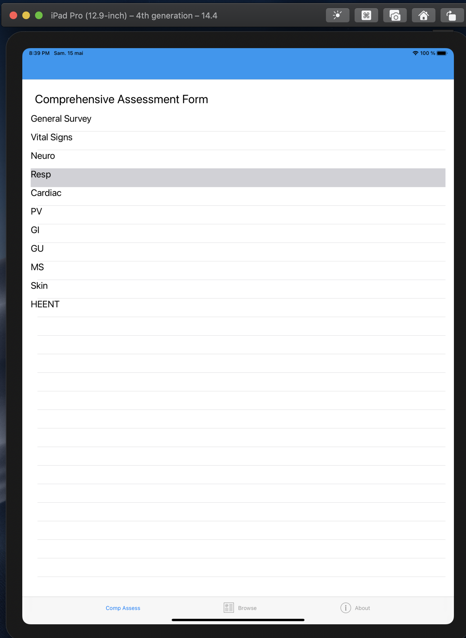
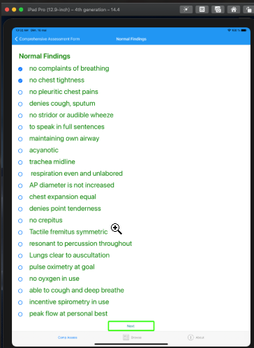
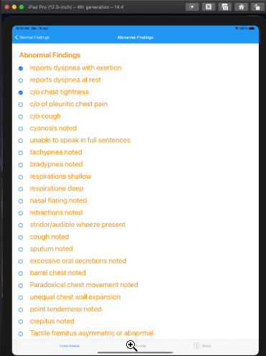
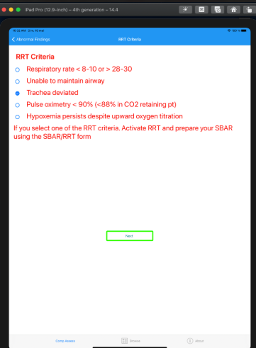
Sample form 1
Sample form 2
Team 508 Digital Clinical Judgment Mentor

Slide 6
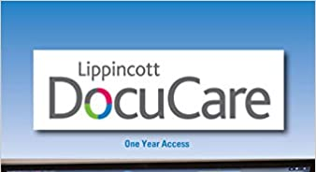

Competitors
Team 508 Digital Clinical Judgment Mentor

Slide 7
Digital Clinical Judgment Mentor
Get the right information
right person
right time.
Open-Source
Cross-Platform app
HIPAA/FERPA compliant
Promotes quality and safety
Designed to coach decision making
Team 508 Digital Clinical Judgment Mentor
Notes:
Get the right information (CDS)
right person
right time.
Get the right information
right person
right time.

Slide 8
Scalability
First year: free services to schools with nursing programs.
Proceeding years: charge subscription based on number of enrolled students.
Team 508 Digital Clinical Judgment Mentor

Slide 9

Our Team
Team 508 Digital Clinical Judgment Mentor

